Slide 1
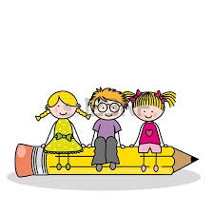
Upper Key Stage 2: Writing

Slide 2
A Key Priority…
As a school we have highlighted writing as a key priority on our school improvement plan.
This means we are aiming to:
Improve the quality of writing that children produce
Enable children to be more involved in their work to deepen their knowledge and understanding
See an improvement in the progress that children make with their writing results.

Slide 3
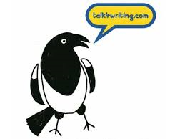
Talk 4 Writing
A new English scheme we are working from which encompasses three key areas:
Imitation
Innovation
Independent application.
We use Talk 4 Writing to teach fiction, non-fiction and poetry units.

Slide 4
1. Imitation – Learn a text together
Become familiar with the structure and key language features of a text.

Slide 5
1. Imitation – Learn a text together
“Once upon a time, a girl’s mother died. Her father decided to get married again to her stepmother. The stepmother hated the girl and gave her no food. The girl had to drive the cattle onto the hillside. One day, she was so hungry that she wished a bird’s egg would crack into her mouth. “

Slide 6
2. Innovation : Change one element of the text
The learnt text is “boxed-up”, and then we look at elements of the story that could be changed:
What if Cinderella didn’t go the ball?
What if the wolf was gentle and kind instead of bad?
What if Jack had traded for gold coins instead of beans?
The children then use these ideas to create a text of their own, keeping most of the original elements but one change.
This develops confidence, and secures understanding of language and structural features.

Slide 7
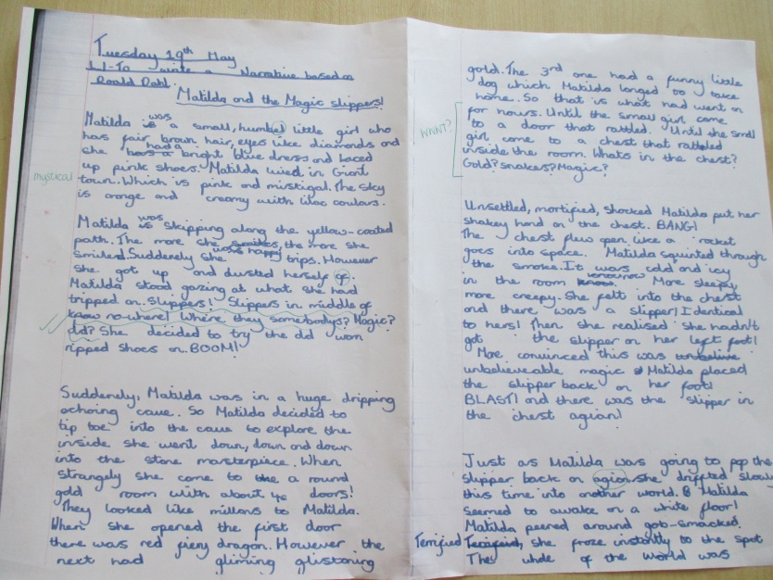
3. Independent Application
By now, the children will have the required knowledge and ideas to put together in a text of their own, which follows the same genre but is written independently. It usually takes 2-3 weeks to reach this stage.

Slide 8
Marking and Feedback
In UKS2 we are using a number of strategies to get children involved in the learning process for writing, and to familiarise them with their own next steps for learning.
AfL strategies: success criteria, self and peer assessment using purple pens
Detailed marking and guidance
Child-friendly target sheets in books

Slide 9
Marking and Feedback
Well done, you have…
What’s wrong with this?

Slide 10
Marking and Feedback
Success Criteria for key features
Pupil’s own target
“Wish” from last piece of work
Teacher’s overall comment
Pupil’s comment based on √√ and “WWWT?”

